Slide 1
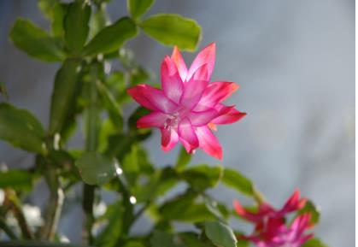
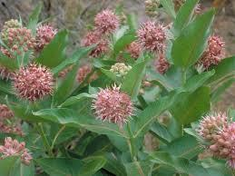
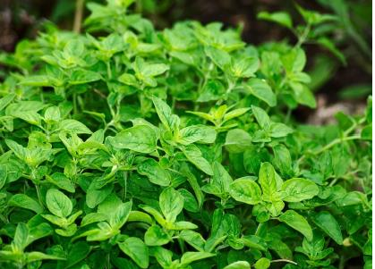
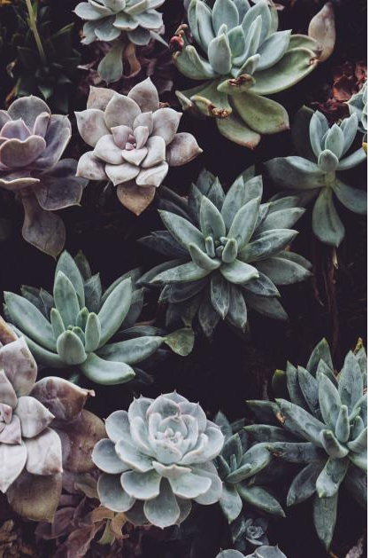
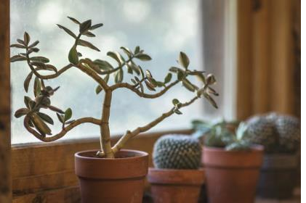
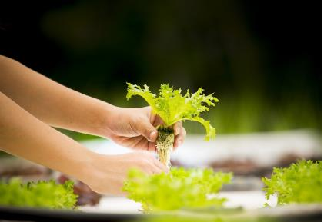
MASTER GARDENERS
POP-UP PLANT GIVEAWAY
SATURDAY, MARCH 2, 8 AM-12 PM
SOUTH COAST RESEARCH CENTER
7601 Irvine Blvd
Irvine, CA 92618
Visit us to see displays and learn about
Hydroponics and Making Picture-Frame
Succulent Gardens
Demonstrations: Make and Take Hydroponic Container
Project (There is a small fee for this activity)
Plant Selections available:
Cool Season Vegetables, Succulents, Houseplants,
Herbs, and CA Natives (incl. Free Milkweed Seeds)
Learn about composting, vermiculture, bees, and more.
• 1 FREE plant for each visitor
• Additional plants $1 and up, each
• Gardening, composting, pest, and irrigation
questions answered by Master Gardeners of
Orange County
Free, Open to the Public
Presented by the
UCCE Master Gardeners of Orange County
mgorange.ucanr.edu mgorange.ucanr.edu/Gardening_Hotline/
It is the policy of the University of California (UC) and the UC Division of Agriculture & Natural Resources not to engage in discrimination against or harassment of any person in any
of its programs or activities (Complete nondiscrimination policy statement can be found at http://ucanr.edu/sites/anrstaff/fi les/215244.pdf). Inquiries regarding ANR’s
nondiscrimination policies may be directed to UCANR, Affirmative Action Compliance & Title IX Officer, University of California, Agriculture and Natural Resources, 2801 Second
Street, Davis, CA 95618, (530) 750-1343.

